Slide 1
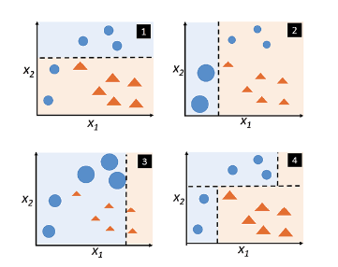
Ada Boosting Algarithm :
From the below diagram, lets understand how adaptive boosting classifier works by ensembling three classifiers (classifier 1, 2 and 3).
The misclassified points are given more weights and weights of correctly classified points get reduced. A new classifier (clf2) is trained with new training data set having more weights assigned to the misclassified points and lesser weights to correctly classified points (thus, adaptive resampling). Look at pic 2 where misclassified points have given higher weight which is represented using larger circle and correctly classified points got reduced in size. New classifier (clf2) again results in misclassification of few points (3 blue points).
The misclassified points classified by clf2 gets higher weights (larger circle) and correctly classified points get lower weights (size reduced). Third classifier (clf3) gets retrained with new training datasets with weights for each data points updated. Take a look at picture 3.
The misclassified points are given more weights and weights of correctly classified points get reduced. A new classifier (clf2) is trained with new training data set having more weights assigned to the misclassified points and lesser weights to correctly classified points (thus, adaptive resampling). Look at pic 2 where misclassified points have given higher weight which is represented using larger circle and correctly classified points got reduced in size. New classifier (clf2) again results in misclassification of few points (3 blue points).
The misclassified points classified by clf2 gets higher weights (larger circle) and correctly classified points get lower weights (size reduced). Third classifier (clf3) gets retrained with new training datasets with weights for each data points updated. Take a look at picture 3.
Finally, the ensemble adaptive boosting classifier (clf4) is constructed by ensembling three classifiers constructed / fitted / trained using different training datasets created as a result of adaptive resampling. Take a look at picture 4 which represents the adaptive boosting (AdaBoost) classifier created by ensembling three classifiers.
Adaboost classifier can use base estimator from decision tree classifier to Logistic regression classifier. As described above, the adaboost algorithm begins by fitting the base classifier on the original dataset. Subsequently, the additional copies of the same base classifier is fitted on the same dataset but the weights of incorrectly classified instances by the previous classifier are adjusted such that subsequent classifiers focus more on difficult cases.
Th

Slide 2
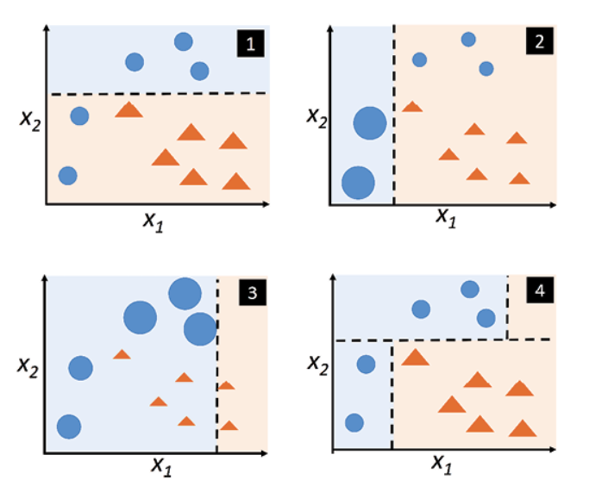
Finally, the ensemble adaptive boosting classifier (clf4) is constructed by ensembling three classifiers constructed / fitted / trained using different training datasets created as a result of adaptive resampling. Take a look at picture 4 which represents the adaptive boosting (AdaBoost) classifier created by ensembling three classifiers.
Adaboost classifier can use base estimator from decision tree classifier to Logistic regression classifier. As described above, the adaboost algorithm begins by fitting the base classifier on the original dataset. Subsequently, the additional copies of the same base classifier is fitted on the same dataset but the weights of incorrectly classified instances by the previous classifier are adjusted such that subsequent classifiers focus more on difficult cases.

